Slide 1



Module 2. Lesson 4.
Memory Card Application P.2
Methodological guidelines

Slide 2

Module 2. Lesson 4. Memory Card Application P.2
Discussion:
Memory Card Application

Slide 3
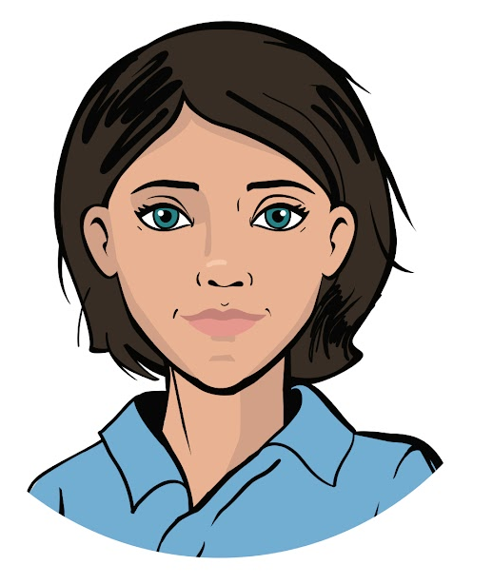

Let’s keep working on that big job
Last time, the ProTeam developers were hired by the “Citizen of the World” Cultural Center.
To sharpen their specialists’ knowledge of cultures and languages all over the world, the Center has asked us to create a Memory Card application.
We’ve already planned our work and programmed the basic interface for this application.
Ready to continue our work?
Discussion of tasks
Emily,
Project Manager

Slide 4
Let’s look at our project’s mind map
Widget creation
Positioning in layouts
Main layout display
Widget creation
Positioning in layouts
Main layout display
Question form display
Answer form display
Memory Card
Some of the project goals are already accomplished
Question storage
Event handling
Question and answer structure
Storage for all questions
Random question display
Handling “Answer” button click
Handling radio button click

Slide 5
Let’s look at our project’s mind map
Widget creation
Positioning in layouts
Main layout display
Widget creation
Positioning in layouts
Main layout display
Question form display
Answer form display
Memory Card
Question storage
Event handling
Today we’ll make the interface work
Question and answer structure
Storage for all questions
Random question display
Handling “Answer” button click
Handling radio button click

Slide 6
The goal of this workday is:
program event handling for the Memory Card application.
Today you will:
Discussion of tasks
review what a group of widgets is, and several parameters for setting a widget’s location
learn the specifics of handling radio buttons
program event handling with specially made handler functions!

Slide 7

Module 2. Lesson 4. Memory Card Application. P2
Qualification

Slide 8
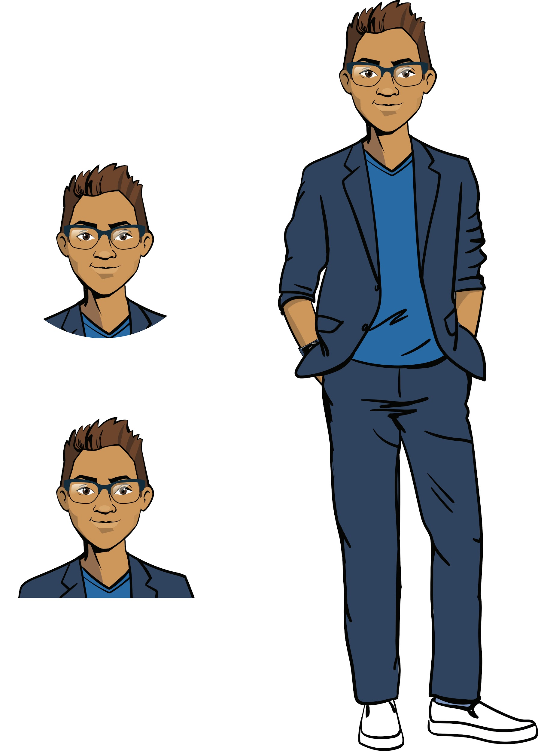
Show your knowledge
of the PyQt library
Qualification

Slide 9
How do you create an application?
What widgets do you know?
Qualification

Slide 10
PyQt5 is
a cross-platform library for creating windowed applications.
from PyQt5.QtCore import Qt
from PyQt5.QtWidgets import QApplication, QWidget, QPushButton, QLabel, QVBoxLayout
Object | Designation
Application | QApplication
Application window | QWidget
Label | QLabel
Button | QPushButton
Vertical guide line | QVBoxLayout
Qualification

Slide 11
What is event handling?
How do we handle a mouse event?
Qualification

Slide 12
Event handling (button click)
Describe the operations of an individual handler function when a button is clicked.
Apply a command for linking the function to the widget.
def show_result():
Proficiency Testing
button.clicked.connect(show_result)
THE ACTUAL FUNCTION IS WRITTEN SEPARATELY
NAME OF THE HANDLER FUNCTION CALLED BY THE BUTTON

Slide 13
How do you create a widget group?
How do you position the widgets inside the group?
Qualification

Slide 14
To create a group of widgets and assign widget positions inside the group:
Create a QGroupBox group (from QtWidgets).
Position the relevant widgets in the layouts separately
Set the main widget layout in the group.
If the widgets we need have already been created, then:
RadioGroupBox = QGroupBox(‘Options’) | A constructor for creating the group
rbtn_1 = QRadioButton('Enets') layout_quest = QHBoxLayout() layout_quest.addWidget(rbtn_1) | Create radio button, Create layout line, Add radio button to it
RadioGroupBox.setLayout(layout_quest) | Create main layout for the group
Qualification

Slide 15
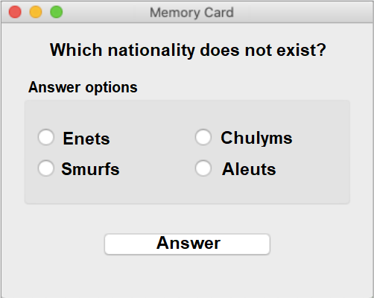
RadioGroupBox = QGroupBox("Answer options")
rbtn_1 = QRadioButton('Enets')
rbtn_2 = QRadioButton('Smurfs')
rbtn_3 = QRadioButton('Chulyms')
rbtn_4 = QRadioButton('Aleuts')
layout_ans1 = QHBoxLayout()
layout_ans2 = QVBoxLayout()
layout_ans3 = QVBoxLayout()
layout_ans2.addWidget(rbtn_1)
layout_ans2.addWidget(rbtn_2)
layout_ans3.addWidget(rbtn_3)
layout_ans3.addWidget(rbtn_4)
layout_ans1.addLayout(layout_ans2)
layout_ans1.addLayout(layout_ans3)
RadioGroupBox.setLayout(layout_ans1)
Qualification

Slide 16
What additional parameters for positioning widgets do you know?
Qualification

Slide 17
Parameters for positioning widgets
Command | Designation
alignment=Qt.AlignHCenter alignment=Qt.AlignVCenter | Centering (horizontally) Centering (vertically)
stretch=2 | Stretch the widget (for example, a button)
layout_card.setSpacing(5) | Set spacing between contents of layout (for example, between horizontal lines)
Qualification

Slide 18
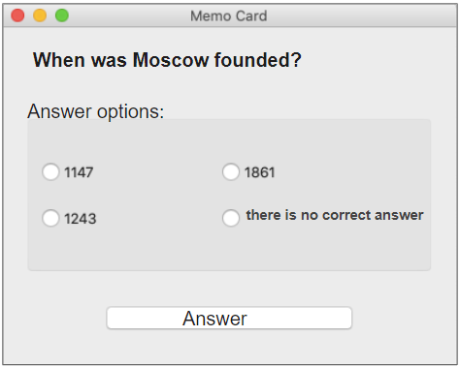
How do you stretch the “Answer” button?
Qualification

Slide 19
The Stretch parameter
layout_line3.addWidget(btn_OK, stretch=3) | Stretch the widget button three times
Qualification

Slide 20
How do we align the question to the left?
Qualification

Slide 21
The Alignment parameter:
layout_line1.addWidget(lb_Question, alignment=Qt.AlignLeft) | Align left
Qualification

Slide 22
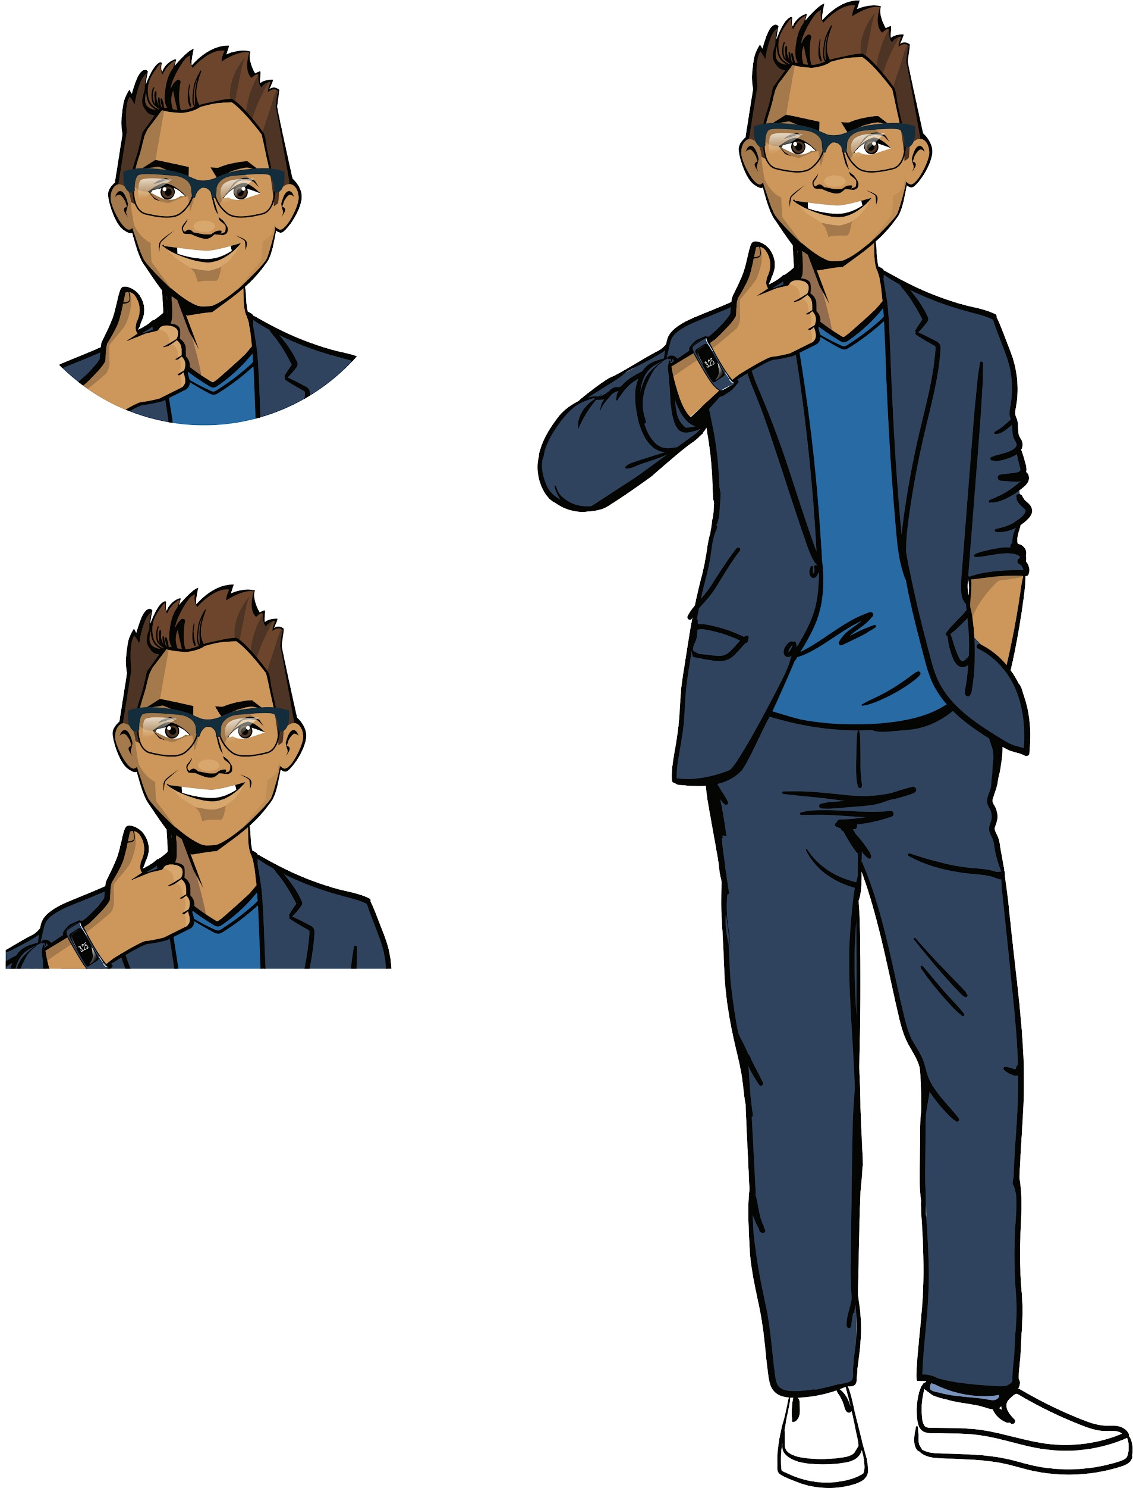
Qualification confirmed!
Excellent, you’re ready for brainstorming and the task ahead!
Qualification

Slide 23

Module 2. Lesson 4. Memory Card Application P.2
Brainstorming
Event handling

Slide 24
Project mind map:
Widget creation
Positioning in layouts
Main layout display
Widget creation
Positioning in layouts
Main layout display
Question form display
Answer form display
Memory Card
Question storage
Event handling
Question and answer structure
Storage for all questions
Random question display
Handling “Answer” button click
Handling radio button click
☑️

Slide 25
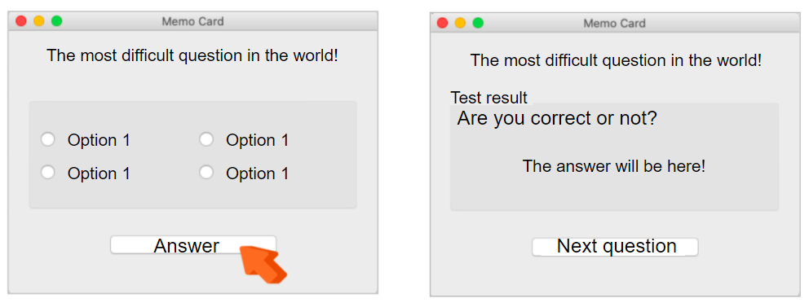
1. Displaying the answer to a question
Clicking “Answer” in the question form:
?
?
?
Brainstorming
Which parts of the interface must be changed? How do we change them?

Slide 26
1. Displaying the answer to a question
Clicking “Answer” in the question form:
hide question form
show answer form
Change label from “Answer” to “Next question”
Brainstorming
How do we program this?

Slide 27
1. Displaying the answer to a question
def show_result():
The handler function that displays the answer form.
hide question form,
show answer form,
Change label from “Answer” to “Next question”
Brainstorming
#...
btn_OK.clicked.connect(show_result)
Calling the function when the “Answer” button is clicked.

Slide 28
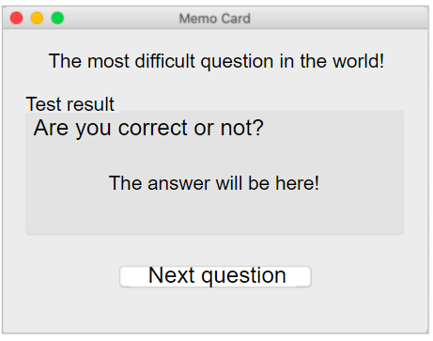
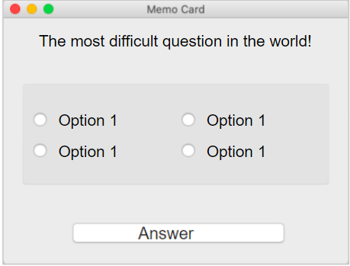

2. Displaying the question and answer options
Answer form, click “Next question”:
?
?
?
Brainstorming

Slide 29
2. Displaying the question and answer options
Answer form, click “Next question”:
hide the answer form,
show the question form,
change the inscription "Next question" to "Answer".
Brainstorming
Is it enough?

Slide 30
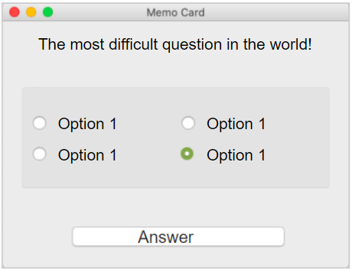
2. Displaying the question and answer options
Answer form, click “Next question”:
hide answer form,
show question form,
change the label “Next question” to “Answer”
Brainstorming
The previous choice will remain!
No! The radio buttons won’t actually reset!

Slide 31
2. Displaying the question and answer options
Answer form, click “Next question”:
hide answer form,
show question form,
change the label “Next question” to “Answer”
reset all radio buttons
Brainstorming
How do we program this?

Slide 32
2. Displaying the question and answer options
RadioGroup = QButtonGroup()
RadioGroup.addButton(rbtn_1)
RadioGroup.addButton(rbtn_2)
RadioGroup.addButton(rbtn_3)
RadioGroup.addButton(rbtn_4)
#...
We are uniting all the radio buttons in a special group.
Now only one of them can be selected at a time.
interface
Brainstorming
RadioGroup.setExclusive(False)
rbtn_1.setChecked(False)
rbtn_2.setChecked(False)
rbtn_3.setChecked(False)
rbtn_4.setChecked(False)
RadioGroup.setExclusive(True)
Let’s remove the limits for the choice reset.
Reset the choice for all radio buttons.
Bring back the limits.
show_question()

Slide 33
2. Displaying the question and answer options
def show_question():
Handler function that displays the question form.
hide answer form,
show question form,
change the label “Next question” to “Answer”,
reset all radio buttons.
Brainstorming
#...
But the button click is already being handled by how_result()!
What do we do?
How do we choose the correct handler function after a click?

Slide 34
3.Function that chooses the handler function
Yes
Is the label on the button “Answer”?
No
show_result()
show_question()
Brainstorming
def start_test():
If the label on the button says “Answer,” call function show_result().
Otherwise, call show_question().

Slide 35
Let’s bring it all together:
#uniting the radio buttons into a special group
def show_question():
Function body
def show_result():
Brainstorming
Function body
def start_test():
Function body
btn_OK.clicked.connect(start_test)

Slide 36
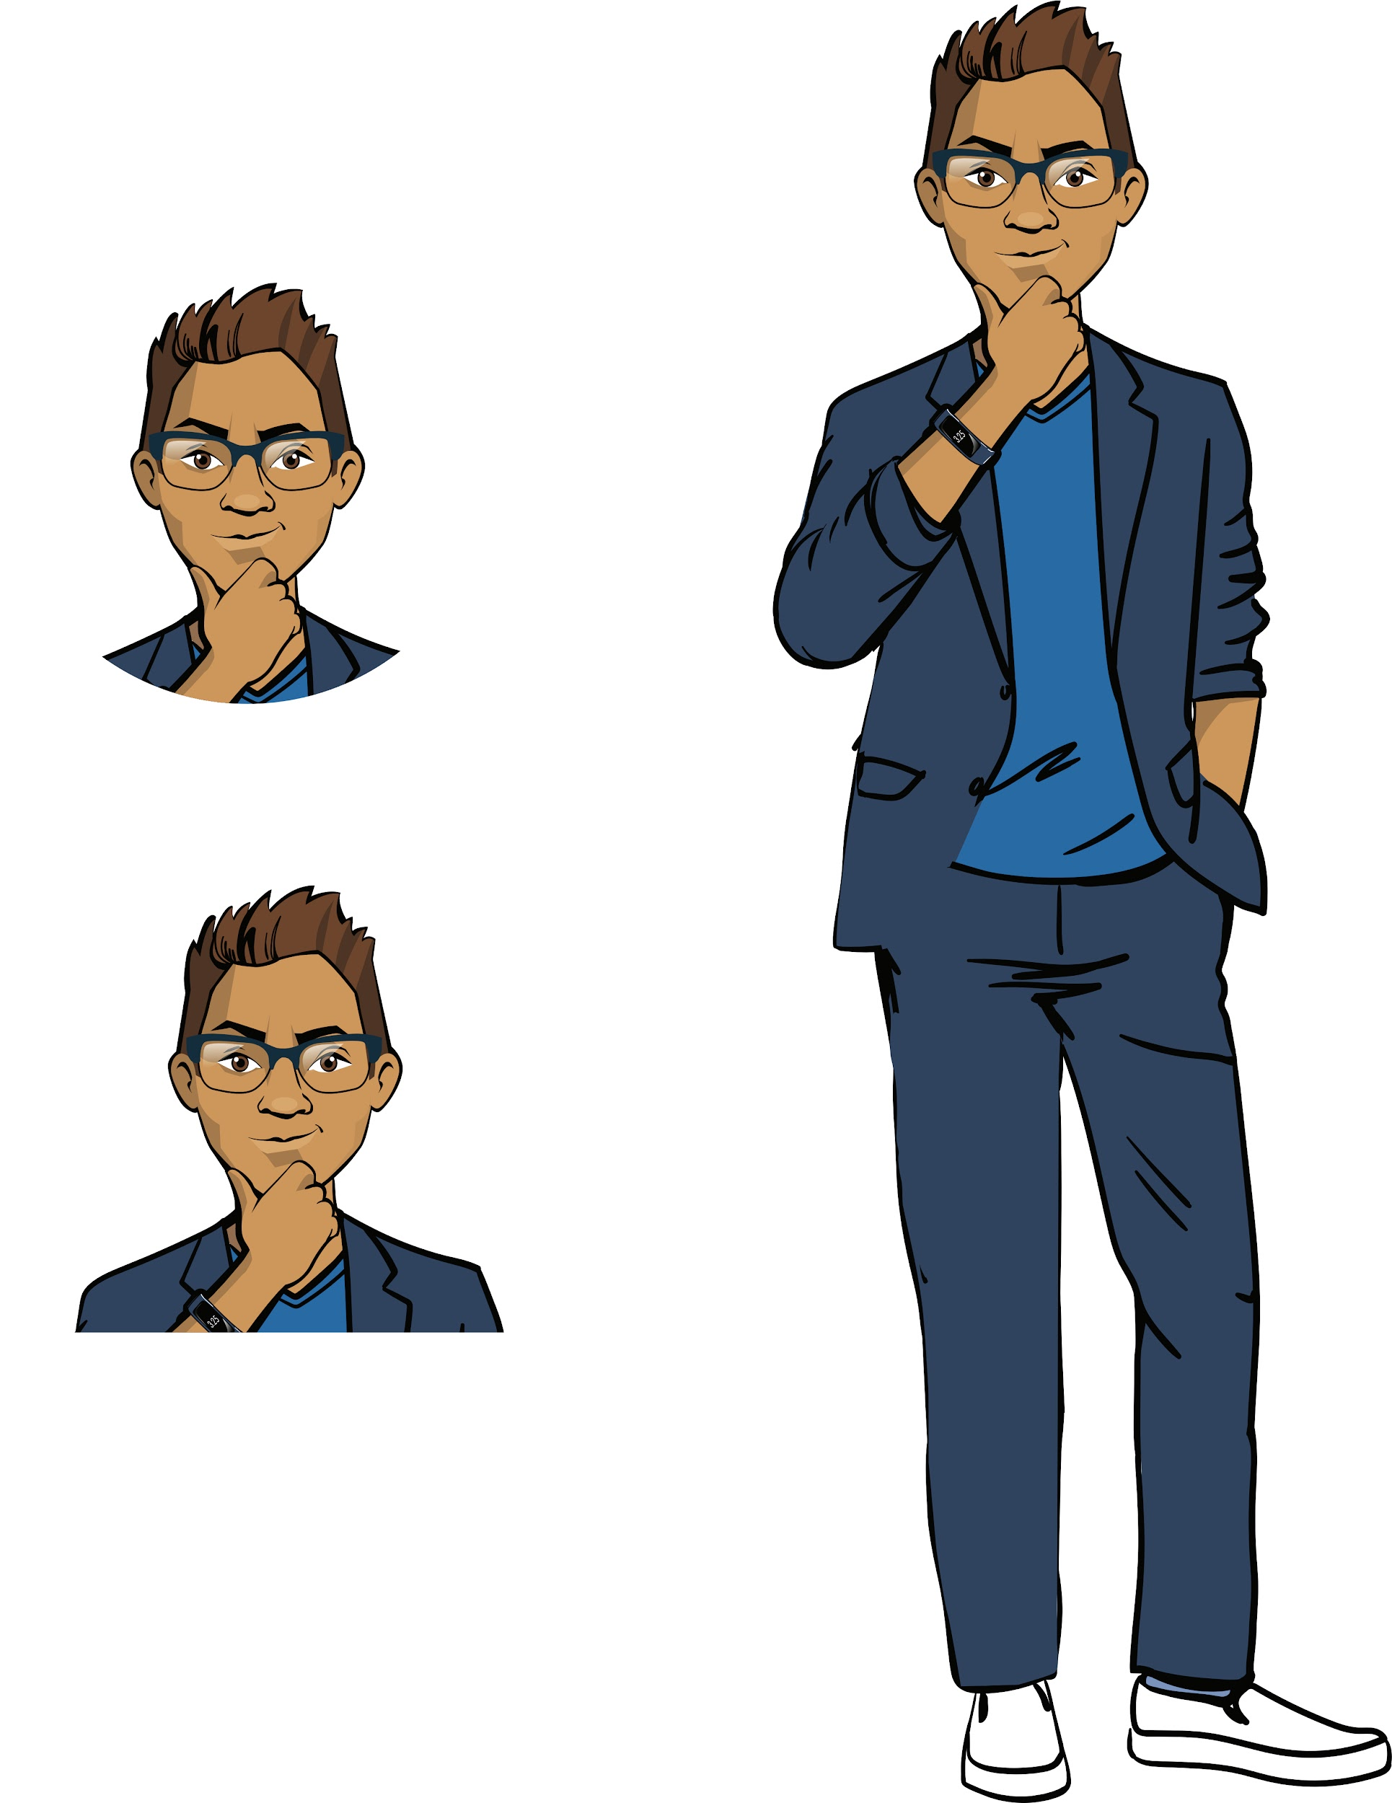
Before we continue, let’s clarify:
Why unite the radio buttons into a special group? How should we link it from PyQt?
How do we use different functions to handle a click of the same button?
What will the program display if you do the following in order:
launch the program,
choose an answer option and click “Answer”
look at the correct answer and click “Next question”?
Brainstorming

Slide 37
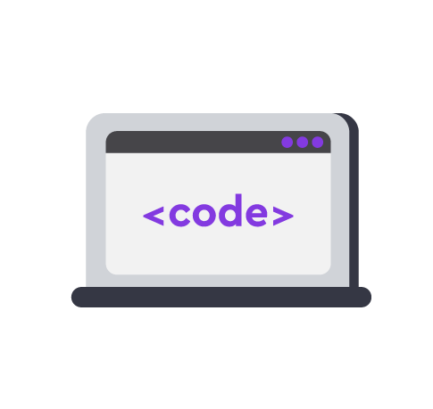
Module 2. Lesson 4. Memory Card Application P2
Visual Studio Code:
Memory Card Application

Slide 38


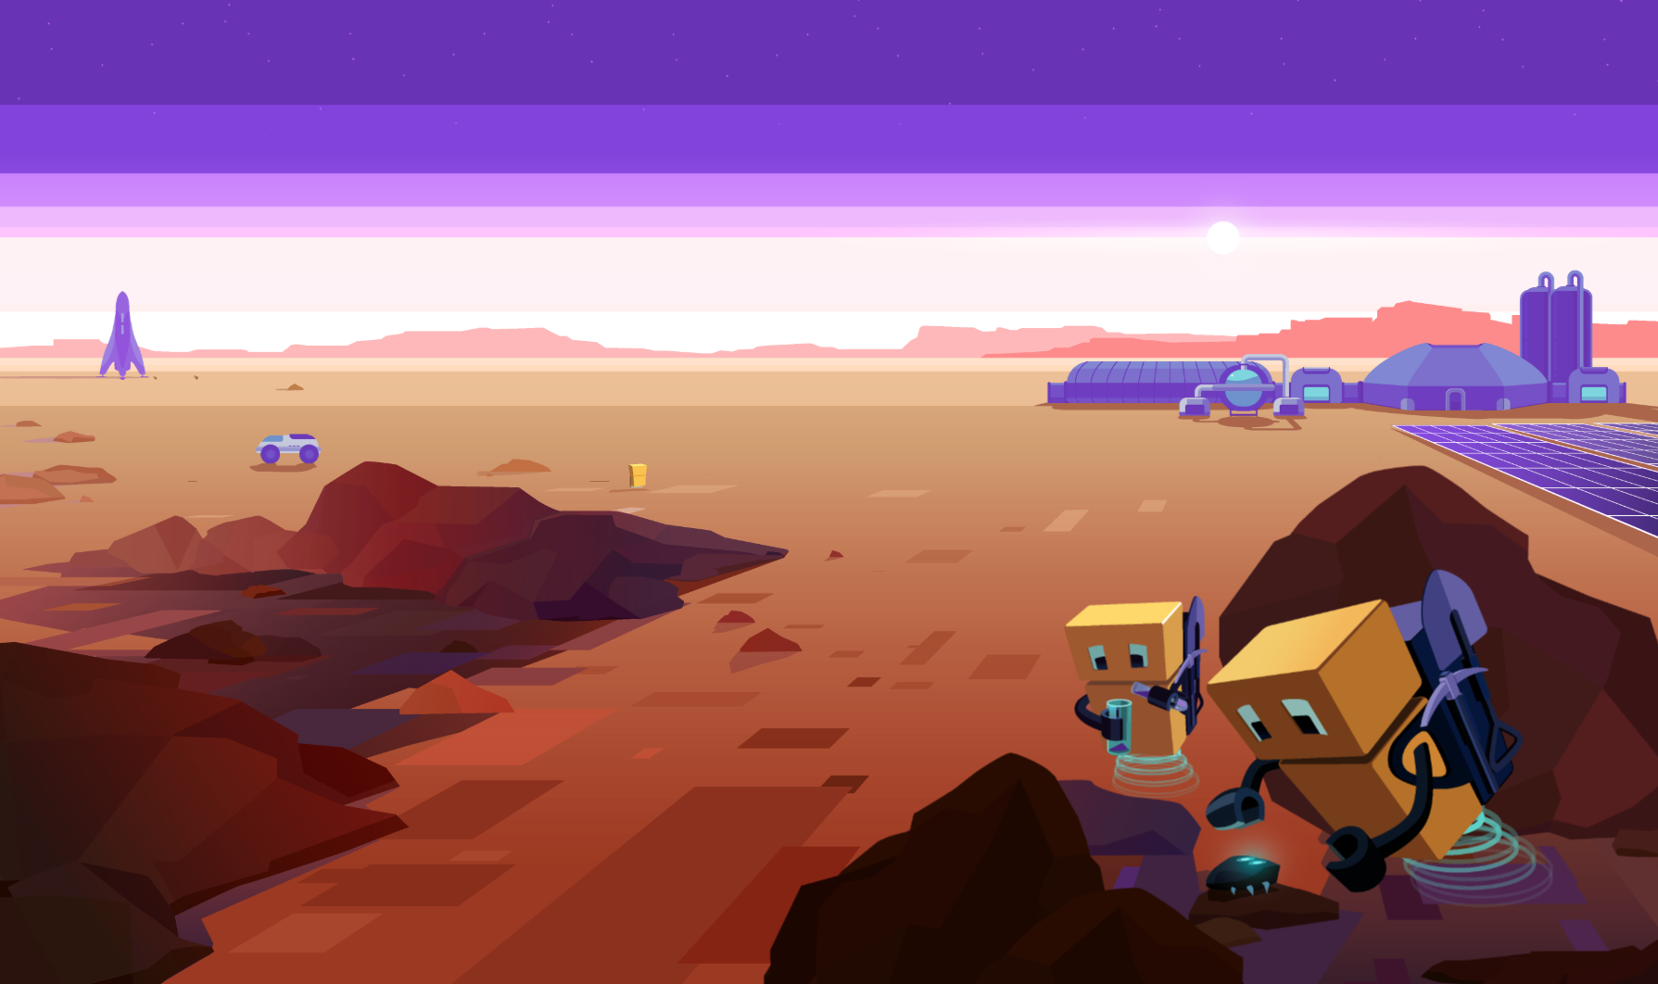
Complete the task in VS Code
“VSC. PyQt. Memory Card”
Visual studio code «Algorithmics»
Application content

Slide 39
Module 2. Lesson 4. Memory Card Application P.2
Brainstorming:
Question display

Slide 40
Project mind map:
Widget creation
Positioning in layouts
Main layout display
Widget creation
Positioning in layouts
Main layout display
Question form display
Answer form display
Memory Card
Question storage
Event handling
Question and answer structure
Storing all questions
Question display
“Answer” button click handling
Radio button click handling
☑️
☑️

Slide 41
How do we ask a question?
We used to display the question by initially putting the necessary labels on widgets.
Now we’ll try to describe an ask() function that asks a question and a check_answer() that checks the answer.
If we can do this for one question, then, next time, we can expand this solution for the entire set of questions.
Brainstorming

Slide 42
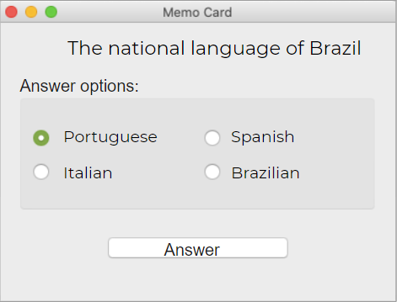
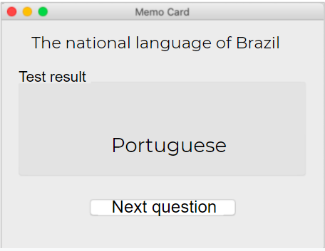
1. Displaying the question in the form
Let the question and answer options be given in lines. Let’s describe the ask() function:
def ask(question, right_answer, wrong1, wrong2, wrong3)
Brainstorming

Slide 43
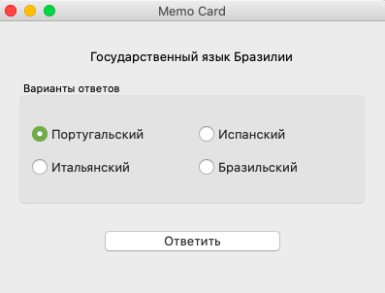
1. Displaying the question in the form
Let the question and answer options be given in lines. Let’s describe the ask() function:
def ask(question, right_answer, wrong1, wrong2, wrong3)
How do we put the data lines in the widgets?
Brainstorming

Slide 44
1. Displaying the question in the form
Let the question and answer options be given in lines. Let’s describe the ask() function:
:
def ask(question, right_answer, wrong1, wrong2, wrong3)
How do we put the data lines in the widgets?
Here’s one possibility: put the ith answer option into the ith radio button.
right_answer
rbtn_1
...
...
Brainstorming
wrong3
rbtn_4
question
lb_question
right_answer
lb_correct
Should we use it?

Slide 45
1. Displaying the question in the form
Let the question and answer options be given in lines. Let’s describe the ask() function:
:
def ask(question, right_answer, wrong1, wrong2, wrong3)
How do we put the data lines in the widgets?
Here’s one possibility: put the ith answer option into the ith radio button.
right_answer
rbtn_1
...
...
Brainstorming
wrong3
rbtn_4
question
lb_question
No! If we do that, the correct answer will always be the first button.
The answers need to be shuffled.
right_answer
lb_correct

Slide 46
1. Displaying the question in the form
#The function writes the value of the question
def ask(question, right_answer, wrong1, wrong2, wrong3):
shuffle the answer options
give the correct answer as a random button while the rest are incorrect
give the question text and give the correct answer in the answer form
display the question form
Brainstorming

Slide 47
1. Displaying the question in the form
#The function writes the value of the question
def ask(question, right_answer, wrong1, wrong2, wrong3):
shuffle the answer options
give the correct answer as a random button while the rest are incorrect
give the question text and give the correct answer in the answer form
display the question form
Brainstorming
How do we shuffle the answer options?

Slide 48
1. Displaying the question in the form
#The function writes the value of the question
def ask(question, right_answer, wrong1, wrong2, wrong3):
shuffle the answer options
give the correct answer as a random button while the rest are incorrect
give the question text and give the correct answer in the answer form
display the question form
Brainstorming
from random import shuffle
answers = [rbtn_1, rbtn_2, rbtn_3, rbtn_4]
shuffle(answers)
We can shuffle the buttons!
Create a list of radio buttons and mix its elements.

Slide 49
1. Displaying the question in the form
#The function writes the value of the question
def ask(question, right_answer, wrong1, wrong2, wrong3):
shuffle the answer options
give the correct answer as a random button while the rest are incorrect
give the question text and give the correct answer in the answer form
display the question form
Brainstorming
from random import shuffle
answers = [rbtn_1, rbtn_2, rbtn_3, rbtn_4]
shuffle(answers)
right_answer
answers[0]
(strings)
(var. buttons)
wrong3
answers[4]

Slide 50
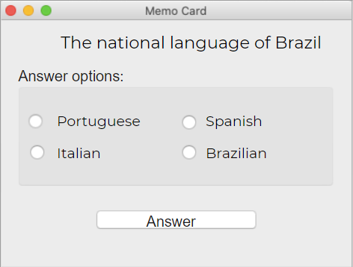
2. Checking the selected answer
Let’s describe the check_answer() function that checks the answer:
def check_answer()
How do we check a given answer and display the result?
A link appeared in the previous function:
right_answer
answer[0]
Brainstorming
wrong1
answer[1]
wrong2
answer[2]
wrong3
answer[3]
Lines of data
Shuffled radio buttons

Slide 51
2. Checking the selected answer
#function that checks the answer to the question and displays the result
def check_answer():
If the first radio button, answer[0], is clicked, then show the message: “Correct”!
If any other radio button is clicked, show the message: “Incorrect!”
Display the answer form and show the correct answer.
The radio button method rbtn.isChecked() checks if the radio button is clicked.
Brainstorming
The operations are performed when “Answer!” is clicked.
Check_answer() replaces the current start_test() function!

Slide 52
Let’s unite them:
def ask(question, right_answer, ...wrong3):
Shuffle the button, linking answer options
(answer[0] is correct).
Display the question in the question form and the correct answer in the answer form.
def check_answer():
Check the answer. If the radio button answer[0] is clicked, then the answer is correct. If any other answer is clicked, then incorrect.
Call show_correct(), passing the line with the result.
Brainstorming
def show_correct(res):
Display the answer form with the correct answer and a res mark (“Correct”/”Incorrect”).
ask('The national language of Brazil', 'Portuguese', ... 'Italian')
btn_OK.clicked.connect(check_answer)

Slide 53
Expected results:
The start_test() will stop working.
The application now has the functions ask(), check_answer() and show_correct() for asking a question and checking the given answer.
Now the application knows how to ask one question, check the answer and display the result.
Brainstorming

Slide 54
Module 2. Lesson 4. Memory Card. Application P.2
Visual Studio Code:
Memory Card Application

Slide 55
Cmoplete the task in VS Code
“VSC. PyQt. Memory Card”
Visual studio code от «Algorithmics»
Application creation

Slide 56

Module 2. Lesson 4. Memory Card Application P.2
Wrapping up the workday

Slide 57

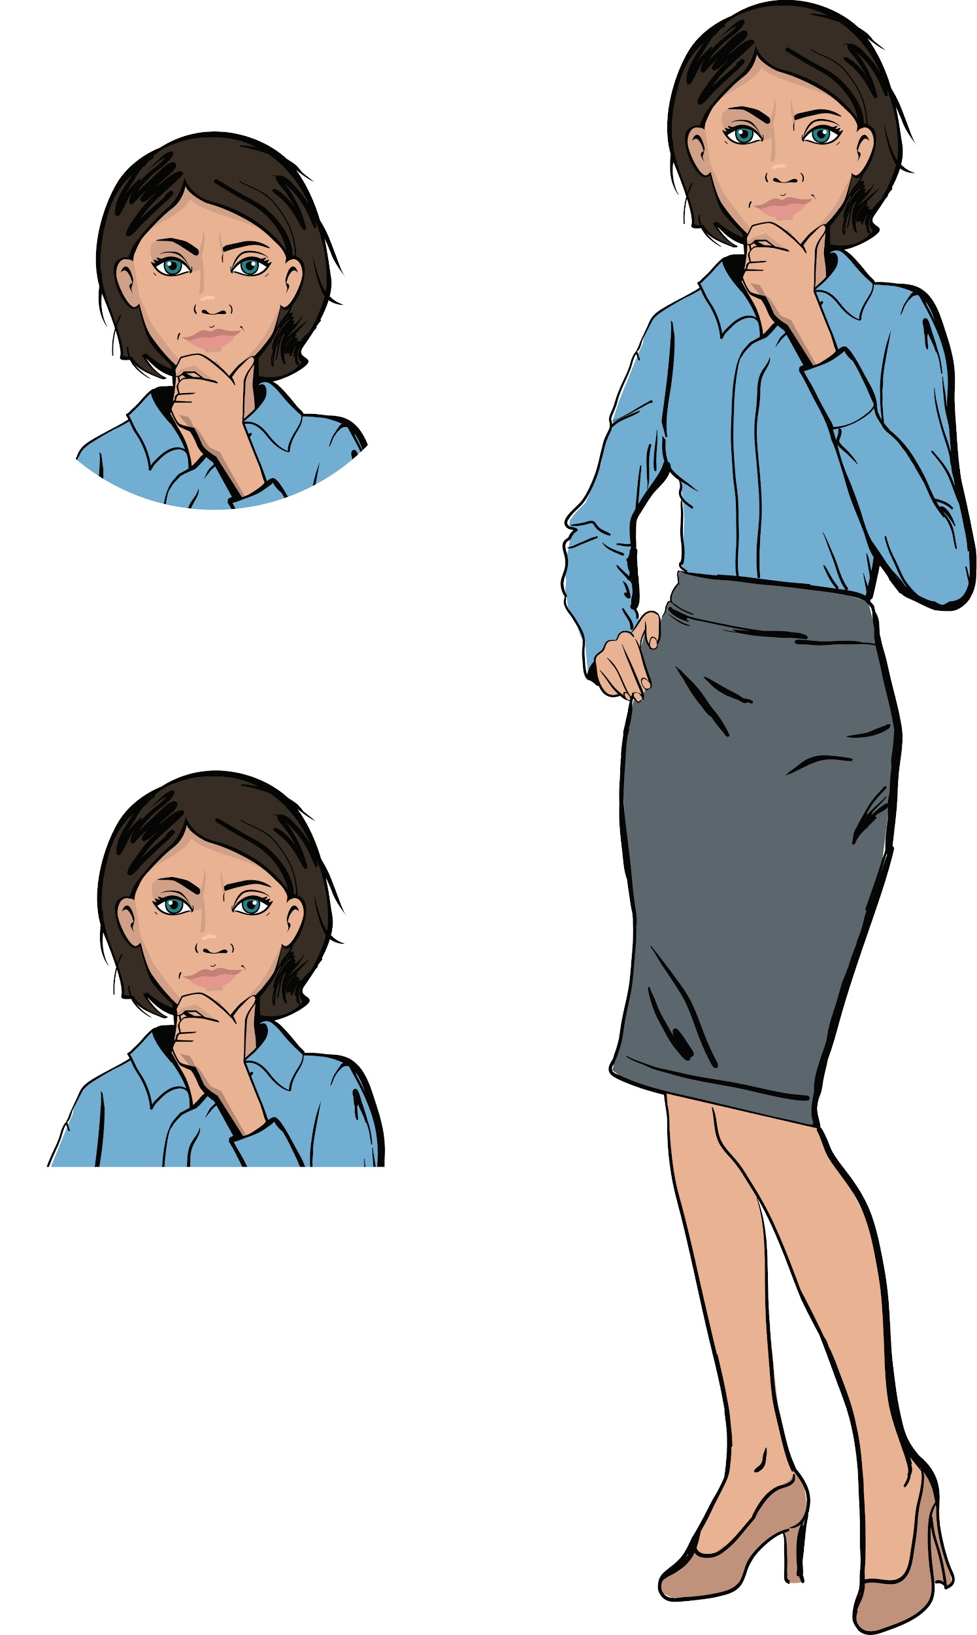
To wrap up the workday, complete this technical interview:
Which method allows us to check whether a radio button has been selected?
How do we create the logical expression: “At least one of three radio buttons has been clicked”?
How do we shuffle the elements in a list? How is this function used in Memory Card?
Wrapping up
the workday
Cole,
Senior Developer
Emily,
Project Manager

Slide 58
How effective was our work?
Together with your colleagues, answer these questions:
What went especially well?
What didn’t go as well as you expected?
What can you do next time to ensure success?
Wrapping up
the workday

Slide 59
Additional tasks
Look at the code you’ve written one more time.
Finish writing the code if necessary.
Add comments to the code to explain
which part of the code does what.
Wrapping up
the workday

